Slide 1
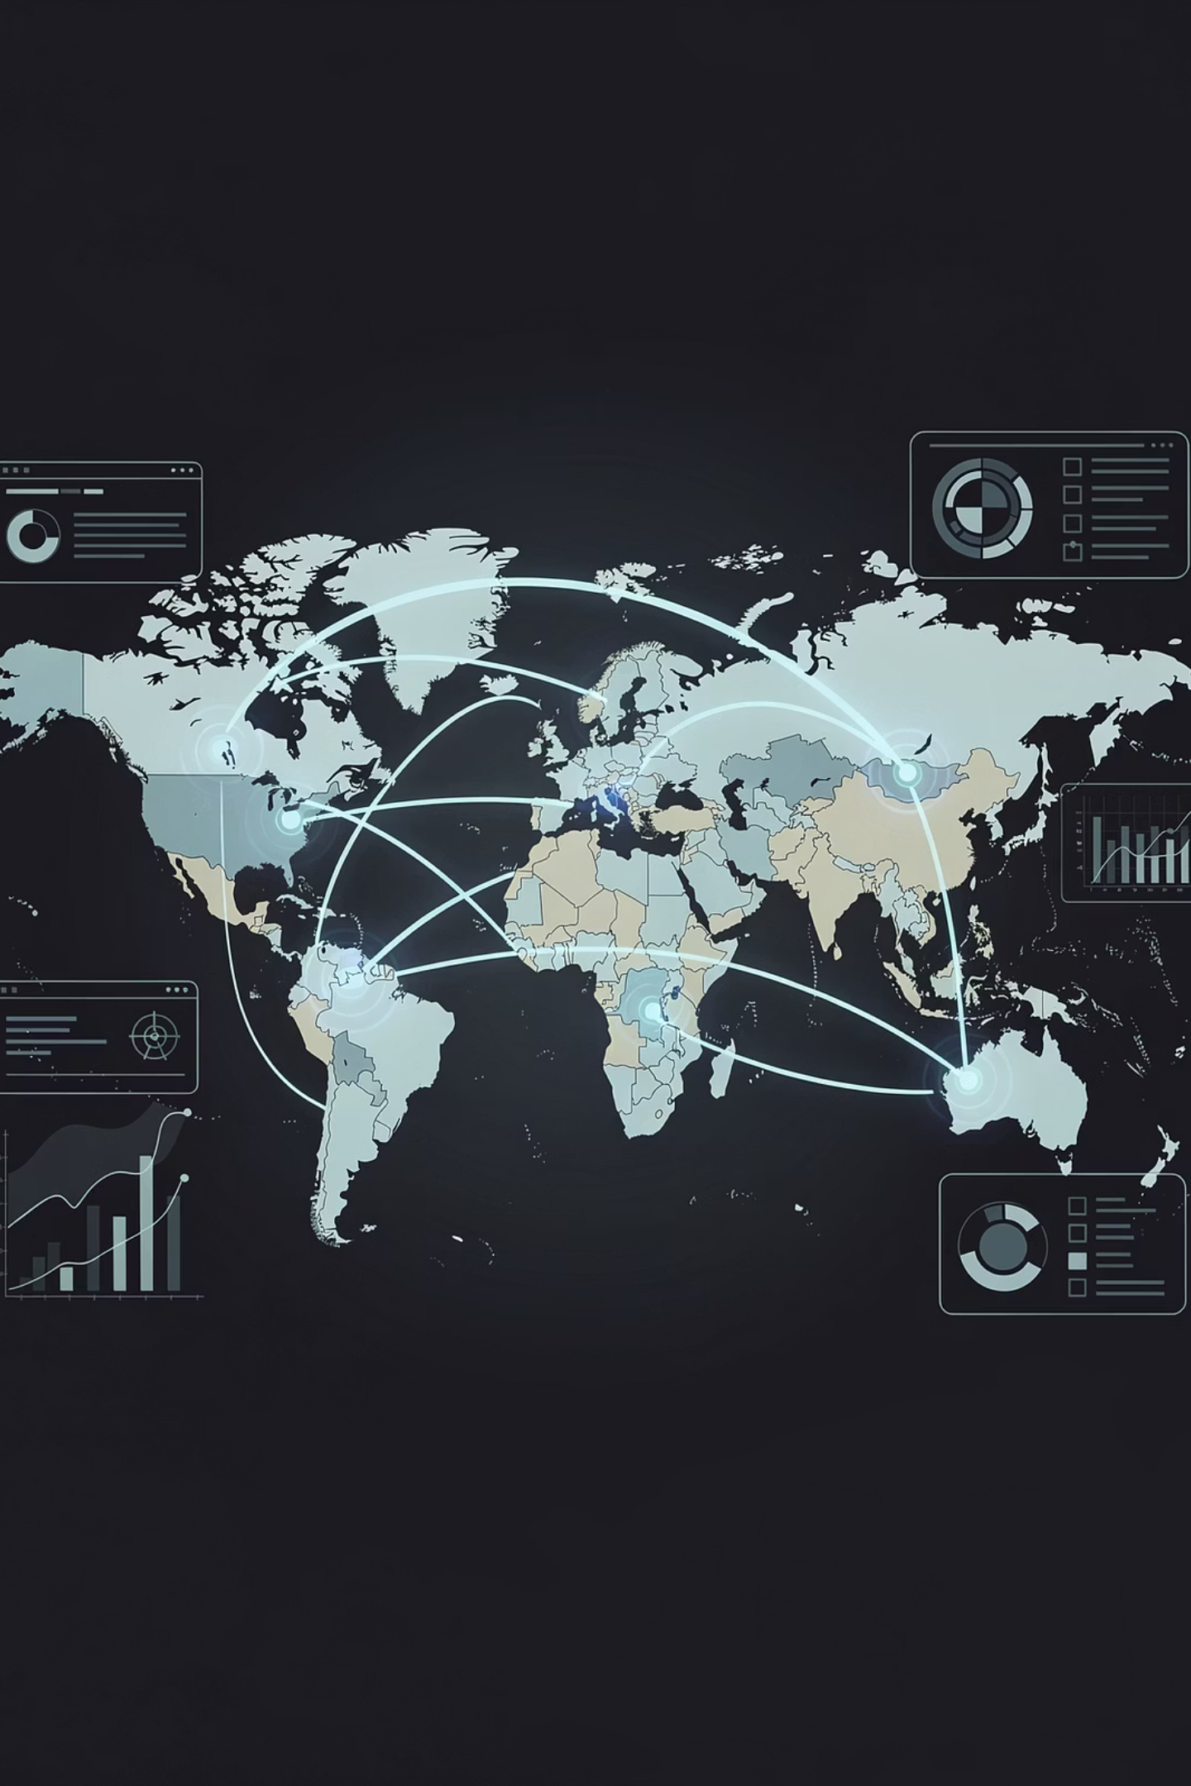
EzeAD
Investor Outreach 2026
We've built what is positioned to become the most structured, search-driven global marketplace infrastructure — already live, indexed, and scaling. We are reaching out to a small group of investors before we formally close our initial round.

Slide 2
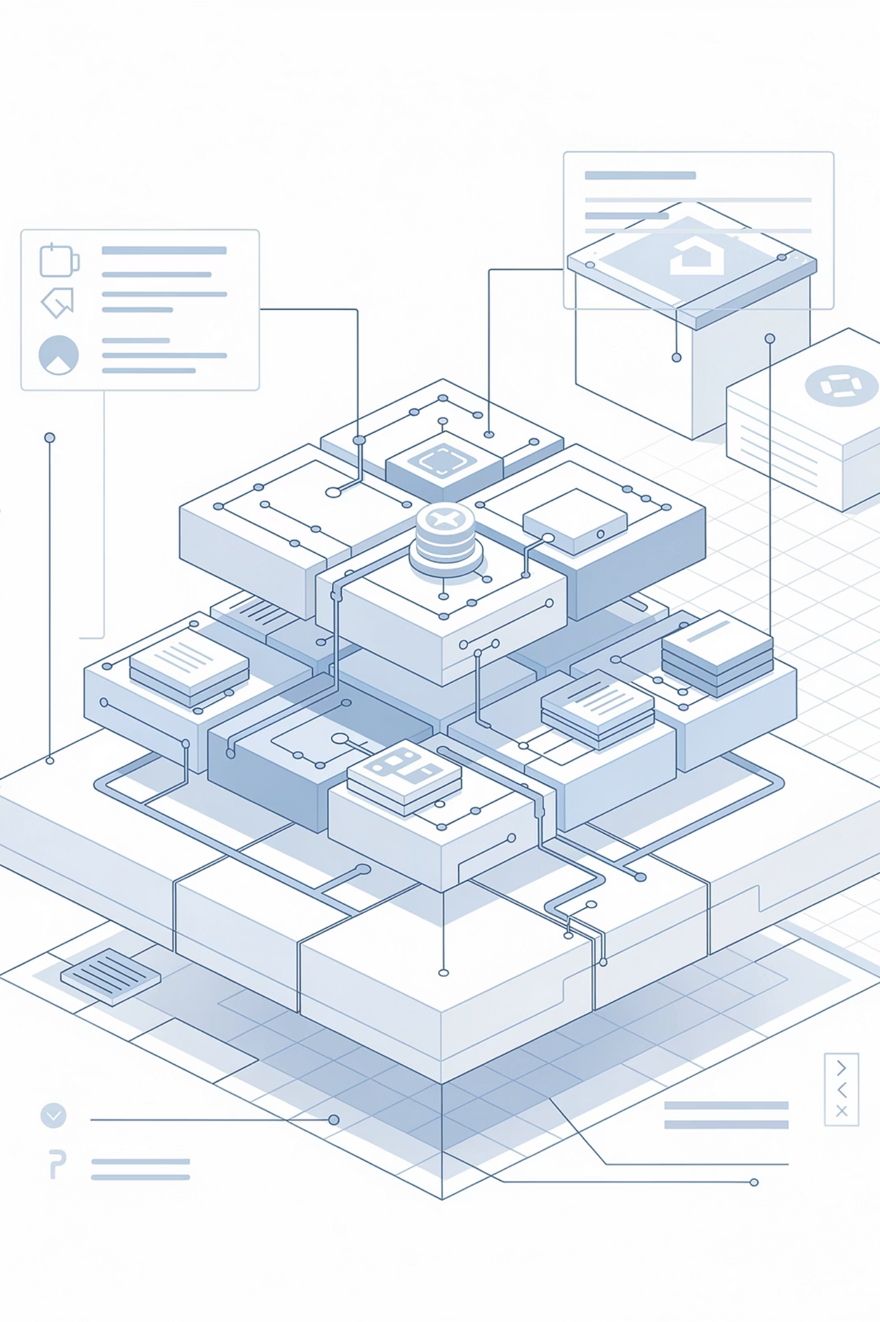
FOUNDER POSITIONING
This Is Not a Concept. This Is Built.
EzeAD is a fully built, operational platform designed to unify global classifieds, services, jobs, real estate, and commerce into a single structured system.
Live
Unified
Platform is fully operational — not in development
One system for all marketplace verticals globally
Scaling
Built for global activation without duplication

Slide 3

WHAT HAS BEEN BUILT
Infrastructure Already in Place
Global Platform
4,000+ Categories
Fully live with structured database of countries, regions, cities, and neighborhoods
One listing distributes globally without duplication across the entire architecture
SEO-First Architecture
Mobile Apps
Designed for continuous indexing and search-driven discovery
iOS and Android apps already built and fully functional
AI Integrations
Admin & Analytics
Live help, posting assistance, and language systems active
Moderation, analytics, and full infrastructure operational

Slide 4

CORE VALUE PROPOSITION
One Platform. One Listing. Global Distribution.
EzeAD replaces fragmented marketplace systems with a unified, search-driven infrastructure — eliminating duplication, inefficiency, and pay-to-play visibility barriers.

Slide 5
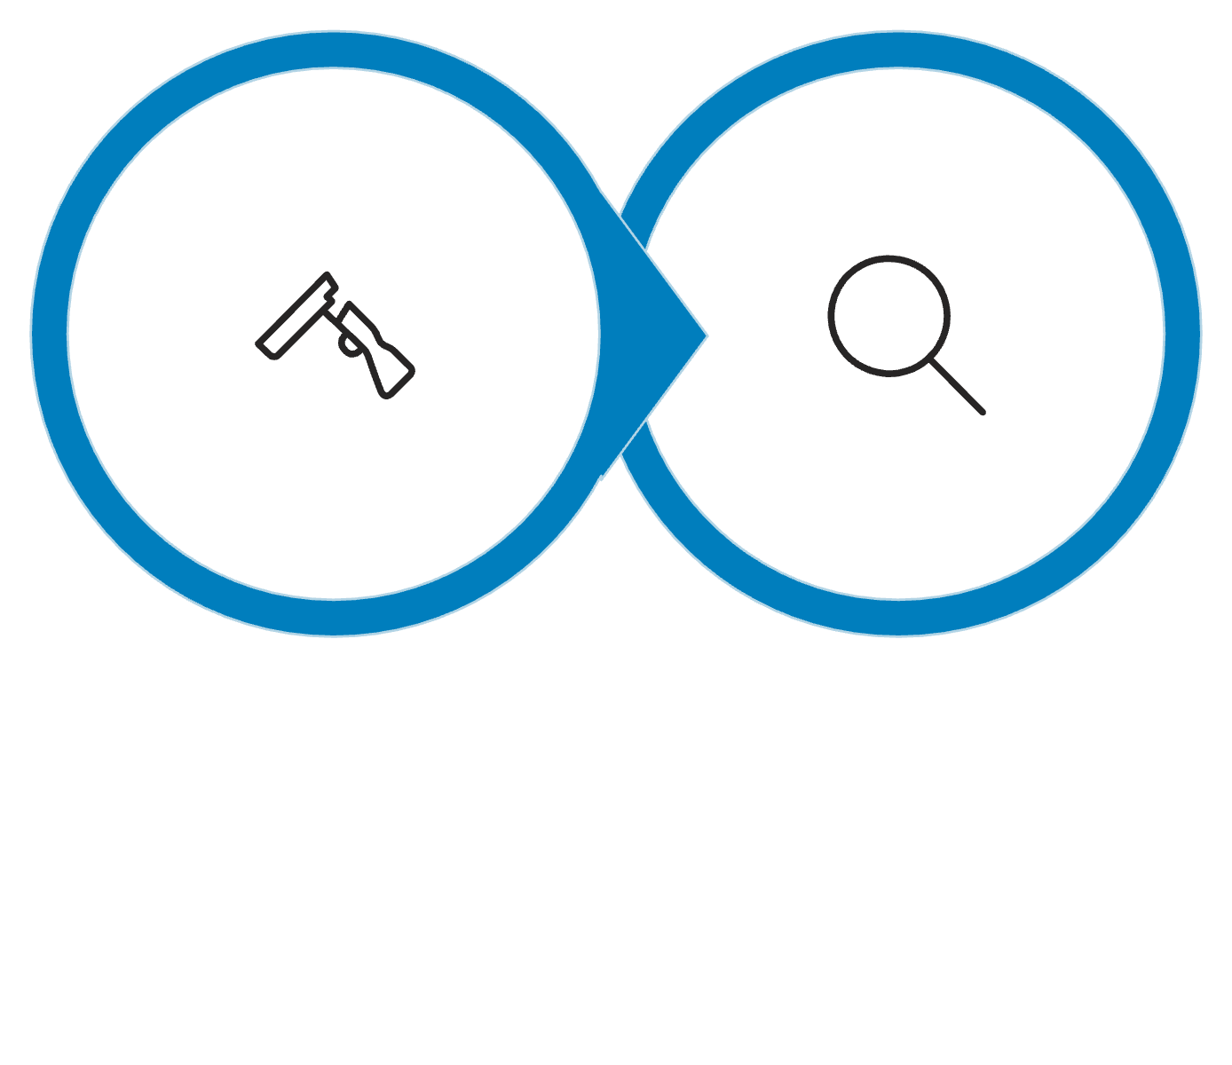
MARKET PROBLEM
Legacy Platforms Are Broken
The Problem
Why Now
Legacy platforms rely on pay-to-play visibility, fragmented systems, and algorithmic suppression — creating inefficiencies and limiting true global reach.
The market is shifting toward search-driven discovery and structured data ecosystems. EzeAD is positioned ahead of this transition — already built, already indexed, already scaling.
Legacy
EzeAD

Slide 6
PROOF & POSITIONING
Traction Without External Funding
4K+
$0
100%
Categories
External Funding
Operational
Structured global architecture live today
Built entirely founder-backed to date
Platform live, indexed, and crawled
The platform is live and indexed with high-performance SEO structure, growing usage, and active crawl activity — all achieved without external investment.

Slide 7
INVESTOR SHOCK SLIDE
Estimated Replacement Cost
If EzeAD were built today from scratch, the estimated cost would be $600,000 – $2,000,000+. This is not a startup — this is a fully built global marketplace infrastructure.
Component
Estimated Cost
Core platform development
$300,000 – $1,200,000
Backend infrastructure
$150,000 – $500,000
Database architecture
$75,000 – $250,000
Admin & control systems
$75,000 – $200,000
SEO & indexing systems
Significant strategic value

Slide 8

STRATEGIC ADVANTAGE
Built to Win the Infrastructure Layer
Search-First Model
Not dependent on paid visibility — organic, search-driven discovery at its core
Eliminates Fragmentation
Replaces multiple marketplace platforms with one unified global system
No Duplication
Built to scale globally — one listing reaches everywhere simultaneously
Infrastructure, Not Just a Marketplace
Positioned as the foundational layer for global commerce discovery

Slide 9

THE ASK
$5M CAD Funding Round
Use of Funds
What You're Investing In
Accelerate scaling and global rollout
User acquisition campaigns
Infrastructure expansion
A fully operational platform with proven architecture, active indexing, mobile apps, AI integrations, and global distribution — all built without external funding.
We are not raising to build — we are raising to scale.

Slide 10

Let's Talk
We are not raising to build — we are raising to scale.
If this aligns with your investment thesis, we welcome a direct conversation and can provide full access to our materials, platform demo, and supporting documentation.
Platform
Round
Live, indexed, and operational
$5M CAD — closing soon
Next Step
Direct conversation + full materials access
EzeAD — Global Marketplace Infrastructure

